Slide 1
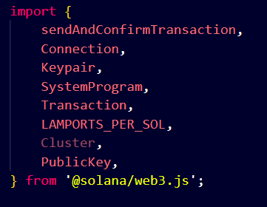
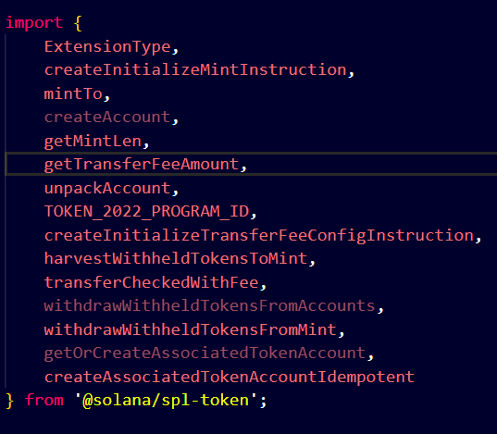
Transfer fee extension
Import necessary functions and constants from the Solana web3.js and SPL Token packages

Slide 2
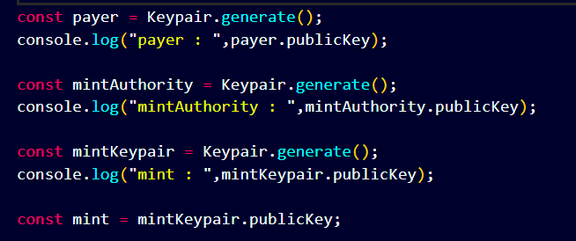
Initialize connection to local Solana node
Generate keys for payer, mint authority, and mint
Payer (Signer) : DJFBE6eAQrCu1KMbxXM8pXJSBwgVUZacb7pquVT2swrY
Mint authority : 3jctKrsSqq5mafKRmprBHvNvkB5N6M7hQ3B16ZfAvT6h
Mint (mint account): EcCbkoR9j3K5HkVSjq4XzmEaXo4Sg9YEchhJTdfB5Xd7

Slide 3
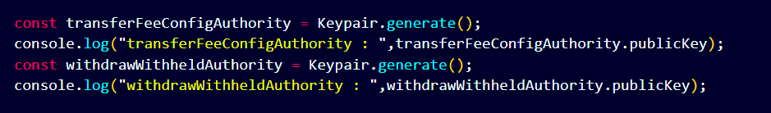
transferFeeConfigAuthority : The authority that will be used to control the transfer fee settings.
transferFeeConfigAuthority : DjW2tVS11HUYB7W14w9fVuAm4fnPVt53RQEXwkgTcVd6
withdrawWithheldAuthority : The authority that will be used to withdraw fees collected.
withdrawWithheldAuthority : Aay2oWkCW4auEXAWnPa2zANCjthtDRUJFqrPiWrcN3KY

Slide 4
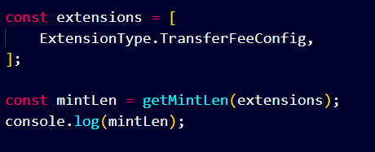
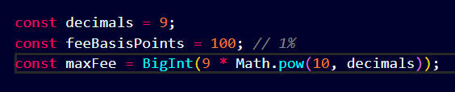
Define the extensions to be used by the mint.
Calculate the length of the mint.
The size of a mint account is crucial because it affects the amount of storage required on the Solana blockchain.
The extension array calculates how much space is needed for our Token-2022 accounts (mint accounts are no longer all 165 bytes--they vary based on the extensions used).
mintLen : 278
Decimal : define lamport and sol relation (1sol = 1 billion lamports)
feeBasisPoints : percentage of transfer as fee.
maxFee : max. fee can be charged.
mintAmount : how many token we want mint.
transferAmount : how many token we want to
transfer

Slide 5
Calculate the fee for the transfer

Slide 6
airdrop some SOL to our payer account. This is necessary to pay for the transaction fees.

Slide 7
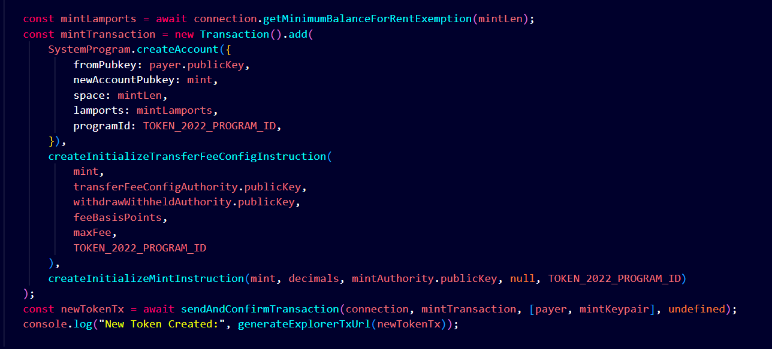
1: Fetch the minimum balance need to exempt an account of dataLength size from rent .
First, we must calculate the minimum balance needed to create the new token. This is done by passing our mintLen into the getMinimumBalanceForRentExemption function. This will ensure our token mint account has adequate space for the extensions we use.
creating our new token :
2: Generate a transaction instruction that creates a new mint account.
3: Construct an InitializeTransferFeeConfig instruction.
4: Construct an InitializeMint instruction.
5: Sign, send and confirm a transaction.
6:

Slide 8
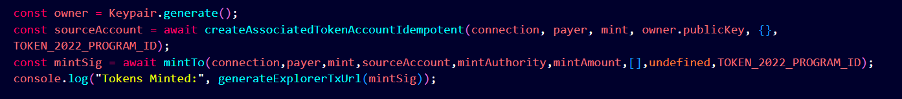
Mint token to source account
we're creating a new keypair(wallet) for the token owner and setting up a source account(token account) for our mint.
The createAssociatedTokenAccountIdempotent function is used to initialize a new associated token account to hold tokens from our newly created mint. We will use this sourceAccount to transfer tokens later.
Then, using the mintTo function, we mint tokens to our source account. We log the returned signature and a URL for viewing the transaction on Solana Explorer.

Slide 9
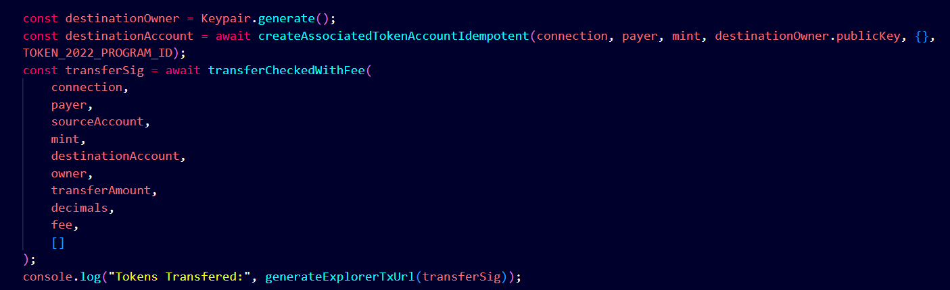
Similar to the previous step, we create a new Wallet, destinationOwner, and a new associated token account, destinationAccount, to define where our funds will go. Then we call a function new to Token-2022, transferCheckedWithFee, to transfer tokens from our sourceAccount to our destinationAccount.

Slide 10
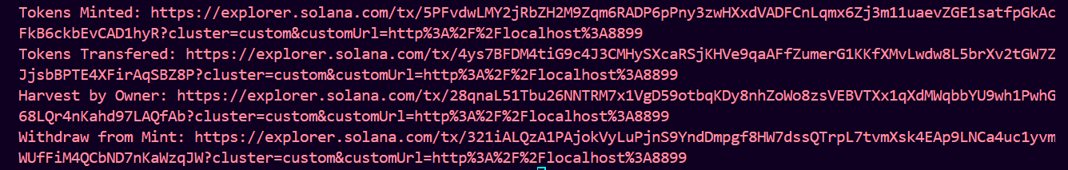
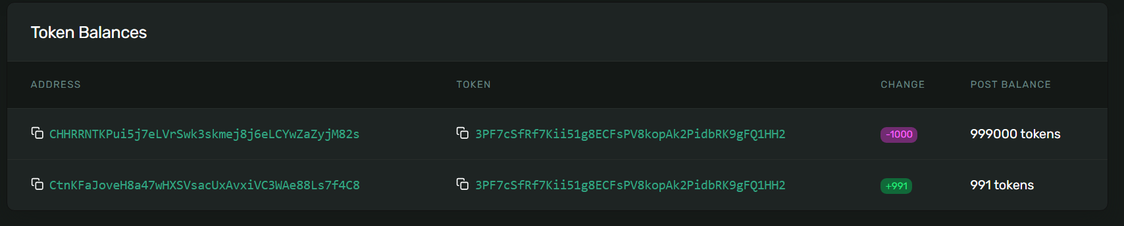
You should see output similar to the following:
If you open the explorer URL for the "Tokens Transferred,"" you should see that 1,000 tokens were transferred from the source account to the destination account, but only 991 tokens were received. The remaining 9 tokens were retained as fees:

Slide 11
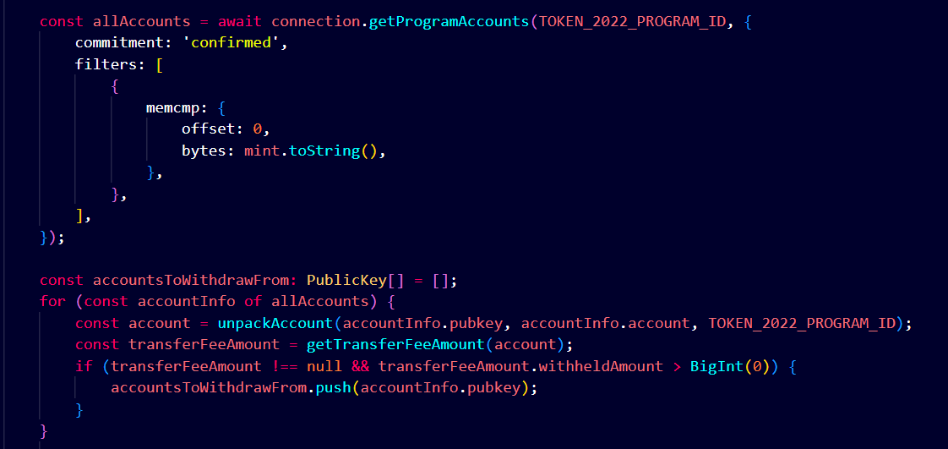
Let's find those tokens!
To withdraw fees collected from transfers, we must find the accounts holding them.
This request looks for accounts owned by the Token-2022 program and filters them by the mint we are interested in (the mint is in the 0 position of the account data).
Decode each account to see if there are any fees to withdraw.
Here's what we are doing:
We create an empty array, accountsToWithdrawFrom, to hold the accounts that have fees to withdraw.
We loop through each account returned from our getProgramAccounts query.
We unpack the account data using the unpackAccount function to deserialize the data into a TokenAccount object.
We check if the account has any fees to withdraw using the getTransferFeeAmount function. If the account has withdrawal fees, we add it to our accountsToWithdrawFrom array.

Slide 12
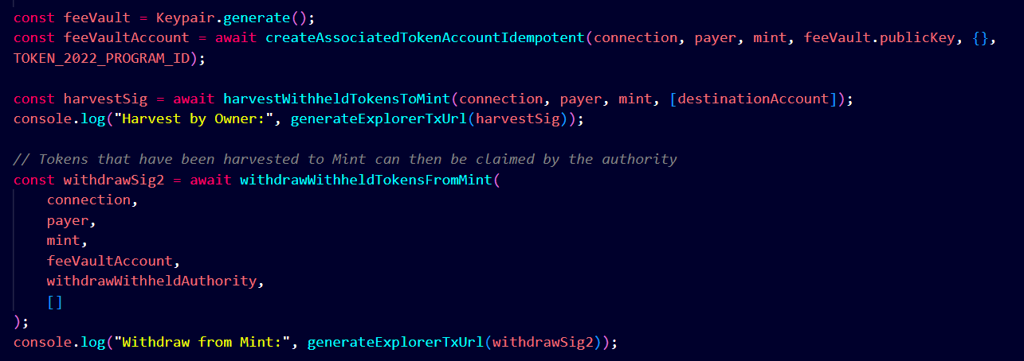
One important thing to understand about fees is that they are pooled at the recipient account, rather than a central fee vault.
There are 2 ways to withdraw fees:
1: triggered by the withdrawWithheldAuthority (using the withdrawWithheldTokensFromAccounts method) .
2: triggered by the account holder (using the harvestWithheldTokensToMint method).
For both scenarios, we create a new wallet, feeVault (and associated token account, feeVaultAccount), to hold the fees we are withdrawing.
Withdraw Fees by Owner
First, we use the harvestWithheldTokensToMint method to harvest fees from the recipient account to the mint.
Once the fees are moved to be associated with the mint account, the authority can withdraw them using the withdrawWithheldTokensFromMint method. This method requires the authority to sign the transaction, so we pass in the withdrawWithheldAuthority wallet

Slide 13
Payer
(Signer)
Mint
(token)
Mint authority
Source account
(token account)
Destination account
(token account)
transferFeeConfigAuthority
withdrawWithheldAuthority
TOKEN_2022_PROGRAM_ID
faucet
Payer-pubKey
mintAccountPubKey
sourceAccountPubKey
transferFeeConfigAuthorityPubKey
mintAuthoritPubKey
destinationAccountPubKey
withdrawWithheldAuthorityPubKey
requestAirdrop(payer.publicKey, 2 * LAMPORTS_PER_SOL)
Airdrop 2 sol
1.
2 sol deposited on payer wallet
Create mint account
2.
createMintAccount(payer, TOKEN_2022_PROGRAM_ID, mint , transferfeeconfigauthority, mintAuthority, withdrawWithheldAuthority, 1%, 9)
Transaction signature
Source token account created
Create and initialize a new associated source token account
3.
createAssociatedTokenAccountIdempotent(payer, mint, sourceWallet.publicKey,TOKEN_2022_PROGRAM_ID)
Source token account pubKey
1,000,000 Token mint to source token account
mintTo(payer, mint ,sourceAccount,mintAuthority,1,000,000, TOKEN_2022_PROGRAM_ID)
Mint tokens to source account
4.
Transaction signature

Slide 14
Payer
(Signer)
Mint account
(token)
Mint authority
Source account
(token account)
destination account
(token account)
transferFeeConfigAuthority
withdrawWithheldAuthority
TOKEN_2022_PROGRAM_ID
Destination token account created
createAssociatedTokenAccountIdempotent( payer, mint, destinationWallet.publicKey, TOKEN_2022_PROGRAM_ID);
5.
Create and initialize a new associated destination token account
Destination token account pubKey
transferCheckedWithFee( sourceAccount, mint, destinationAccount, 1000, 9, 9)
6.
Transfer token from source to destination token acount
1000
991
+ (Fee = 9 token)
One important thing to understand about fees is that they are pooled at the recipient account, rather than a central fee vault.
TransferSig
Decimal = 9
Fee basis = 1%
Max. fee = 9
Transfer amount= 1000

Slide 15
Payer
(Signer)
Mint account
(token)
Mint authority
feeVaultAccount
(token account)
transferFeeConfigAuthority
withdrawWithheldAuthority
TOKEN_2022_PROGRAM_ID
feeVaultAccountPubKey
Fetch all token accounts that are associated with our mint
7.
getProgramAccounts(TOKEN_2022_PROGRAM_ID, mint)
Get array of all accounts
we create a new wallet, feeVault (and associated token account, feeVaultAccount), to hold the fees we are withdrawing.
[accountsToWithdrawFrom]
8.
createAssociatedTokenAccountIdempotent (payer, mint, feeVault.publicKey, {}, TOKEN_2022_PROGRAM_ID);
Creating token account to hold fee
feeVaultAccount pubKey
withdraw fees from the accounts we found
withdrawWithheldTokensFromAccounts ( payer, mint, feeVaultAccount, withdrawWithheldAuthority, accountsToWithdrawFrom)
9.
Transaction Signature

